Slide 1
Statecharts: A Visual Formalism for Complex Systems
- David Harel
Ram Soma
Nimishkumar Parmar
Rohan Kamath

Slide 2
Models
Grady Booch:
Models are the language of designer, in many disciplines
Models are representations of the system to-be-built or as-built
Models are vehicle for communications with various stakeholders
Visual models serve as blueprints
Artefacts at a smaller scale can be used as models.
Models allow reasoning about some characteristic of the real system
Software Model:Artefact(s) made during the development process which abstracts the relevant concerns of the system.

Slide 3
Modelling- Basics
Why model?
  Understanding
  Construction/Communication medium
  Analysis
  Management
Examples
  Software architecture
  Software design
  Prototype

Slide 4
Software modelling- Basics
The essential aspects in modelling software:
Structure/architecture
Behaviour
Data
Interface
Resources

Slide 5
Software modelling- Basics
Desirable qualities:
Abstraction
Refinement
Composition - compositionality
Analysable
Concise
Multiple views

Slide 6
Behaviour
We need to be able to model..
Computational behaviour- E.g.: Invariants
State
Events
Time/Ordering
  Concurrency
Interactions/Communication
  Synchronous
  Asynchronous

Slide 7
Analysis
What properties of the system do we analyse and reason about
Liveness properties
Efficiency: Resource usage
Performance
  Does it meet real time constraints
Evolution
Scalability

Slide 8
Modelling behaviour
Modelling languages/techniques
  State based
    Statecharts
  Logic based
    First order logic
    Temporal logics
  Process Algebras
    CSP based
  UML
  Petri Nets

Slide 9
Modelling behaviour: UML
Use-case diagrams:
  Shows how users interact with system.
  Purpose is to define a piece of an element's behaviour as a system not its internal structure.
Sequence diagrams:
  Represents time and different objects involved.
  Shows the interactions arranged in a time sequence
Collaboration diagrams:
  Shows the instances participating in an interaction that exchange stimuli to accomplish a purpose.
Activity diagram
  Model the workflow/computational behaviour.
Statecharts
  Shows states,events and transitions.

Slide 10
Modelling Behaviour: Petri Nets
A graphical and mathematical modelling tool for describing systems that are characterized as being concurrent, asynchronous, distributed, non-deterministic and parallel.
Can be applied to virtually any area or system.
Petri Nets are described in terms of places and transitions which can roughly be mapped into states and events respectively.
Provides analysis capability- various types of analyses can be done on Petri net models checking for behavioural properties like liveness, fairness etc.
Well understood domain and good tool support for representation, visualization and analysis.
Major weakness of Petri Nets is the complexity problem. Even simple models tend to be large.

Slide 11
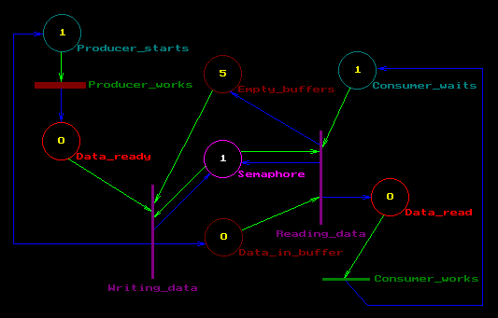
Petri nets
  An example
    The following diagram shows a Petri Net for the classical producer-consumer problem, synchronized through a semaphore.
    Illustrates the power of PNs as well as the potential complexity in using them.

Slide 12
Choosing a technique
Non-trivial: Each technique has it strengths and weaknesses
Depends on the domain.
  E.g. real time embedded systems are reactive systems with timing constraints- thus a notation strong at modelling events and time is needed
Ease of use v/s completeness (wrt needs)
  E.g. formal logic is good for analysis but hardly easy to learn.
  Application at hand and/or design team
Compactness
  State diagram=>state explosion

Slide 13
References
Software Architecture and UML: Keynote speech by Grady Booch at the UML World Conference in New York, 10 March 99
Multiview of software architecture: www.iist.unu.edu/colloquium/Post_Colloquium.data/ Components/Slides/Broy.pdf

Slide 14
Statecharts
Extend conventional transition diagrams with:
Hierarchy
Concurrency
Communication

Slide 15
Statecharts
Features:
Reactive (event-driven) systems
Provide behavioral description
Compact, highly structured, modular and expressive

Slide 16
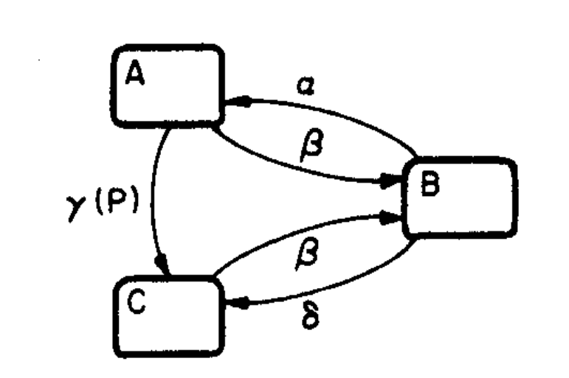
General structure
States=nodes and Arrows=transitions
Event driven
Conditional

Slide 17
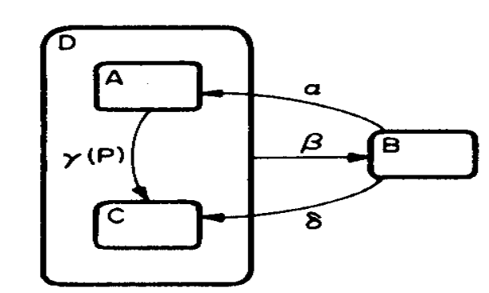
Clustering
Solves the exponential blow-up problem
Provides abstraction
Super-states (hierarchy)
Exhibit XOR of sub-states
Bottom-up approach

Slide 18
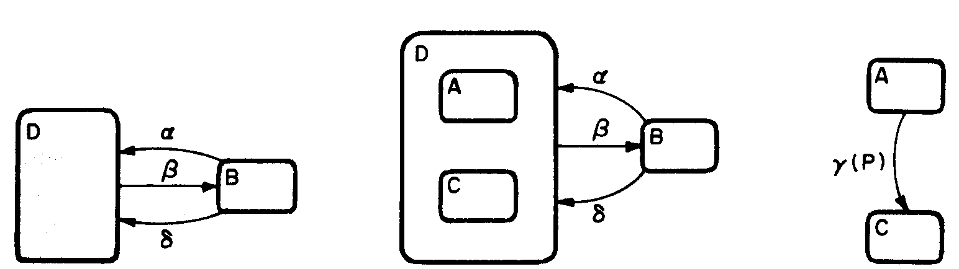
Refinement
Top-down approach
Start with high-level abstraction
Progressively refine
Helps zoom-in and zoom-out

Slide 19
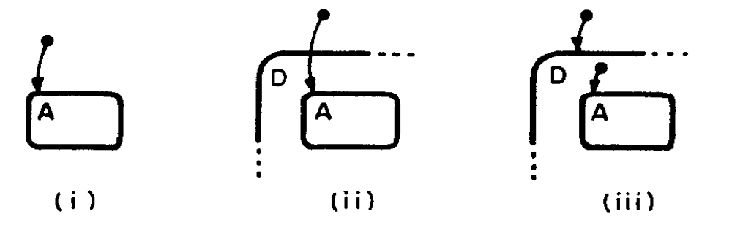
Default states
Specifies the default state among a groups of states

Slide 20
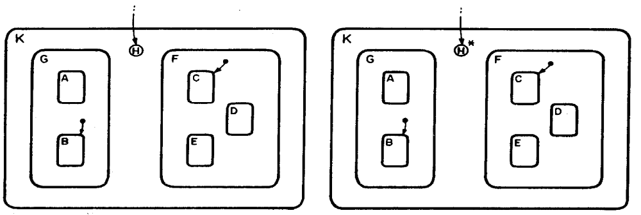
H-entrances
Specifies systems history (most recently visited state)
Applied only on the level in which it appears

Slide 21
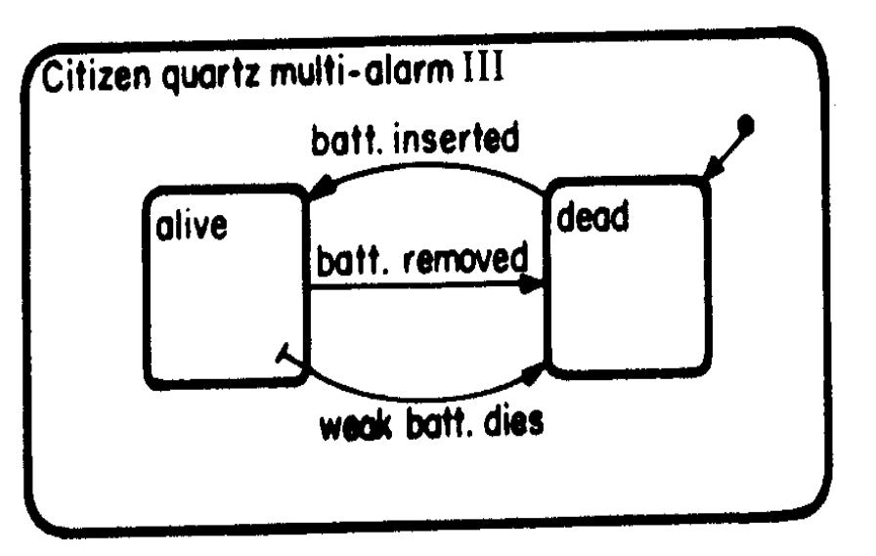
H-entrances special cases
Top-down behavioral specification
Ex: battery insertion and removal in the watch system

Slide 22
New H-istorical interpretations
Battery removal and death
‘H’ to be forgotten if entered in dead state
Use special actions such as clear-history(s)
Default values applied after H-values are cleared

Slide 23
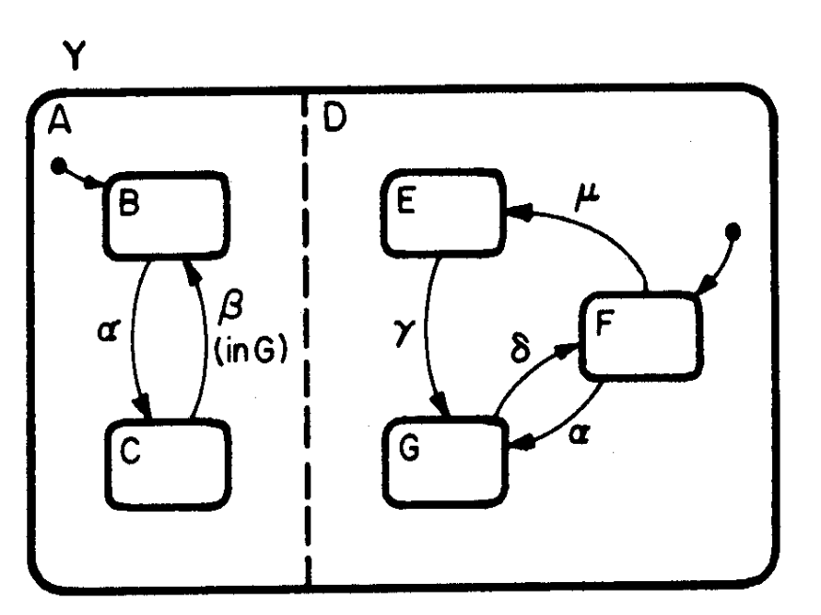
Orthogonality
Exhibits independence and concurrency
AND decomposition
Helps in splitting a state according to its corresponding real-world subsystems

Slide 24
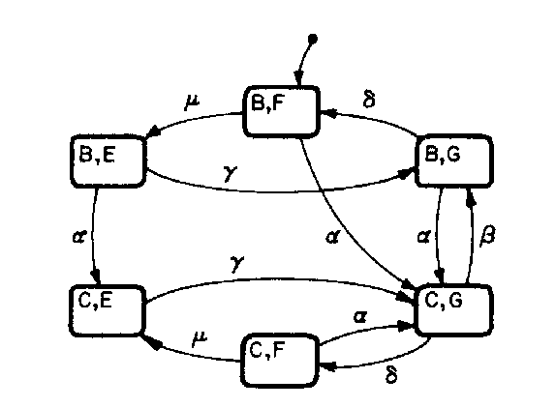
Independence?
AND-free representation
Some dependence (B-transition from C to B)
A depends on D

Slide 25
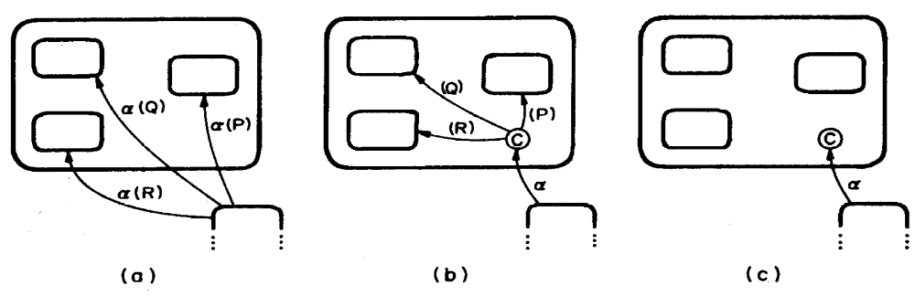
Additional features
Condition entrances
Skip overly complex details (helpful in early development stages)

Slide 26
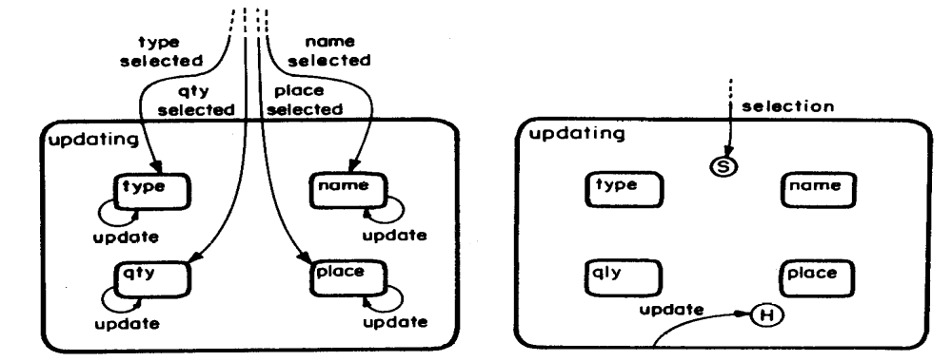
Selection Connective
Event value determines the state
Possible to repeatedly update values

Slide 27
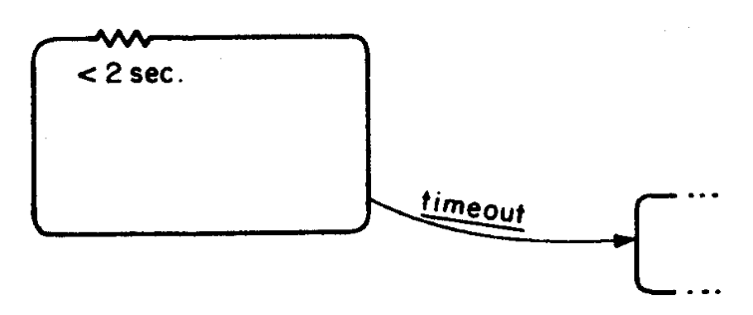
Delays and timeouts
timeout(event, number)
Ability to specify time bounds in a state

Slide 28

My personal view…
Strengths:
Statecharts – good technique, but no panacea
Weaknesses:
Should have briefly talked about real life large scale applications

Slide 29
Overview
Statecharts and UML.
Usefulness in modeling Embedded systems.
Other Uses of Statecharts.
Pros and Cons.

Slide 30
Adoption of Statecharts:
Harel proposed Statecharts in 1984.
Unified Modeling Language (UML) developed in ’97.
UML adopted Statecharts as one of its 9 modeling methods.
So What ?...

Slide 31

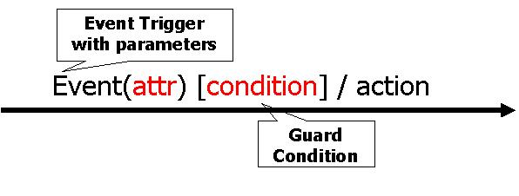
What did Statecharts gain?
Name
entry/activity
do/Action
exit/activity

Slide 32
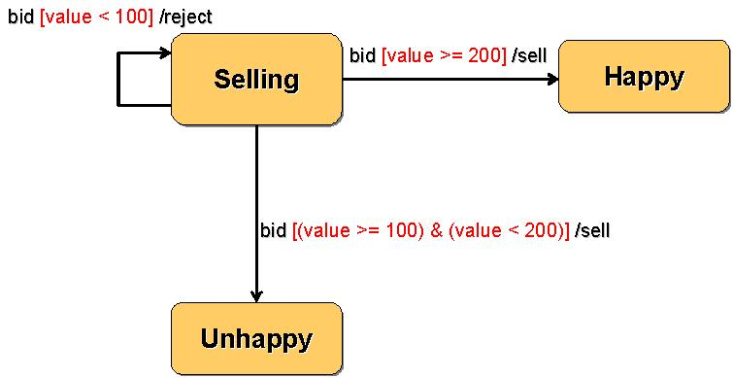
Example:

Slide 33
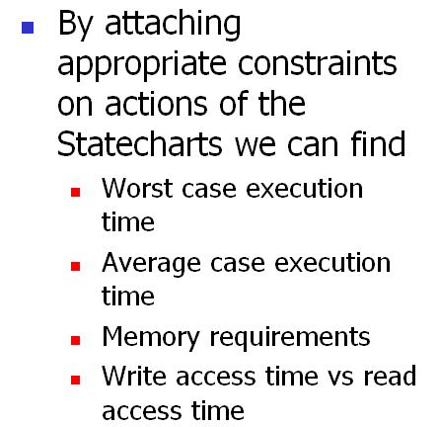
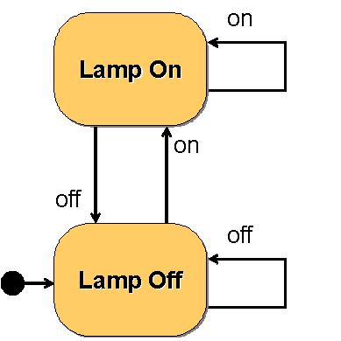
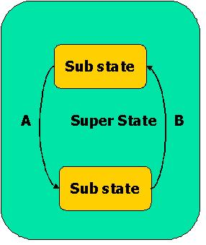
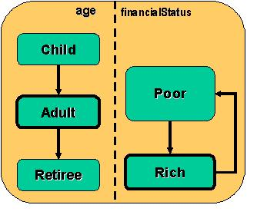
Why use Statecharts for Embedded systems?
Dynamic behavior
Concurrency
Hierarchy
Event Driven behavior
de-emphasizes computation.
QOS ?

Slide 34
Other Uses
Behavior Testing
  Automation
  existence of a formal specification introduces the possibility of automating much of the test generation process and thus of increasing the effectiveness and reducing the cost of testing.
  Testing final state
  A transition may produce the expected output and yet be erroneous because it leads to the wrong final state.
    E.g. Pacemaker.

Slide 35
Other uses (contd …)
Code generation
  There are tools available which will convert Statechart definition into actual code.
  Such tools are very useful for Embedded system developers because once the skeleton classes are ready they only have to worry about functionality and not about behavior
  E.g. Rational Rose, Rhapsody.

Slide 36
Other Application Areas:
  Safety-critical systems
  Networking Protocols
  GUIs (Graphical User Interfaces)
  OOD (Object-Oriented Design)

Slide 37
Pros
Provides Formal Model for describing reactive behavior
Its Visual
Avoids State Explosion
Its been Tried and Tested

Slide 38
Cons:
Cannot model systems with continuous behavior.
Formal testing of Statecharts is still under research.
The paper doesn’t provide any clues about what kind of analysis we can do on Statecharts especially on properties like …
  Liveness.
  Efficiency.
  Performance.

Slide 39
References
D. Harel. Statecharts: A Visual Formalism for Complex Systems. Science of Computer Programming, pp. 231-274, 1987
Article by Bruce Powell Douglass on www.embedded.com

Slide 40
Questions…
Ram (rsoma@usc.edu)
Nimish (nparmar@usc.edu)
Rohan (rohankam@usc.edu)

